Slide 1
Productivity Boosters for .NET Developers
by Jon Kruger

Slide 2
Learn your IDE
Notes:
-Print out the keyboard shortcuts
-Regex find and replace
-Ctrl-Arrows, incremental search
-Close the solution explorer
-Turn off toolbars and menus

Slide 3
ReSharper
Notes:
Real time errors
Find type
Find file
Move to folder
Rename

Slide 4
Lose the mouse

Slide 5
AutoHotKey
Notes:
Move 5 chars
Remap Caps Lock to End

Slide 6
Get a clipboard manager
Notes:
CLCL

Slide 7
Small tasks

Slide 8
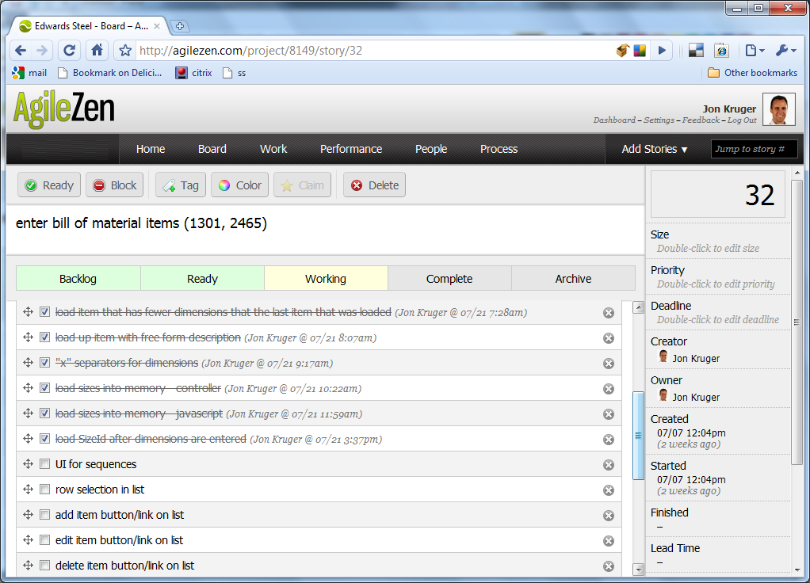

Slide 9
Automate everything
Notes:
Builds
Deployments
Code generation
Live templates
File templates

Slide 10
Eliminate distractions

Slide 11
Keep learning
Notes:
Strive to get better each day in every area of your life

Slide 12
Have a plan
Notes:
Set goals for yourself

Slide 13
Think long term!
Notes:
Make smart, long-term decisions
Don’t lose common sense in an attempt to finish your current task as fast as you can

Slide 14
?
Notes:
Make smart, long-term decisions
Don’t lose common sense in an attempt to finish your current task as fast as you can

Slide 15
My Info
Email: jon@jonkruger.com
Twitter: @JonKruger
Blog: http://jonkruger.com/blog
These slides:

